Slide 1
Brand Yourself
a professionalization workshop for grad students
Dr. Emily McGinn
Digital Humanities Coordinator
mcginn@uga.edu
Joey Stanley
DigiLab Reasearch Assistant
joeystan@uga.edu
DigiLab, UGA Library
November 11, 2016

Slide 2
Social Media

Slide 3

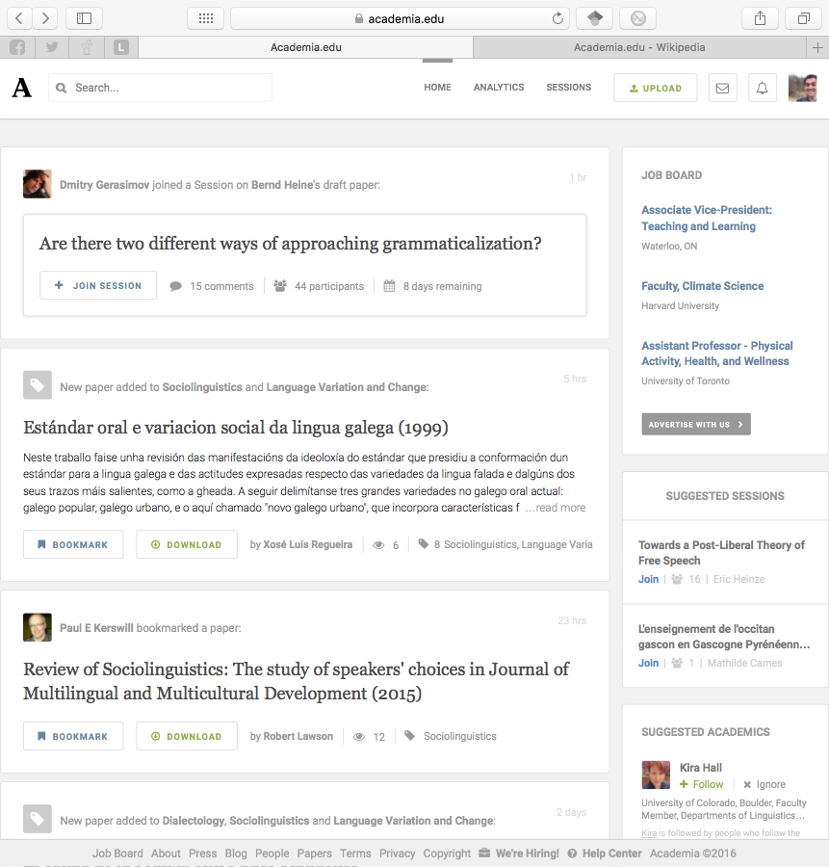
Academia.edu
Social networking site for academics
30 million users
The LinkedIn for smart people
Features:
connect with other researchers
read each others’ papers
analytics
free
Notes:
Overview

Slide 4
Academia.edu
Academia.edu keeps track of people, papers, and topics you’re interested in.
Papers you might like
New uploads
Who is reading what
Suggested jobs, people, topics
Notifications when people you follow upload something new
Notes:
Discover others

Slide 5
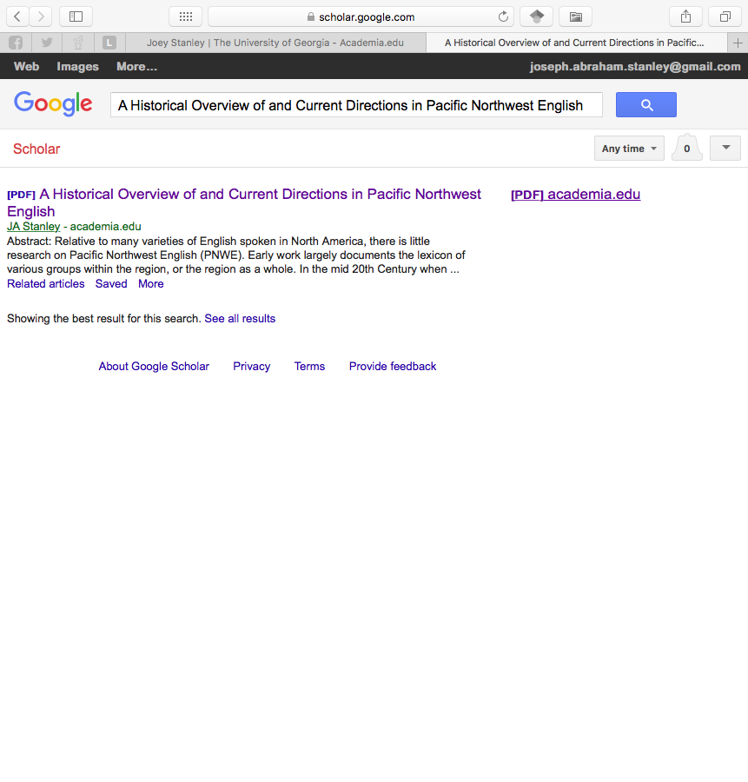
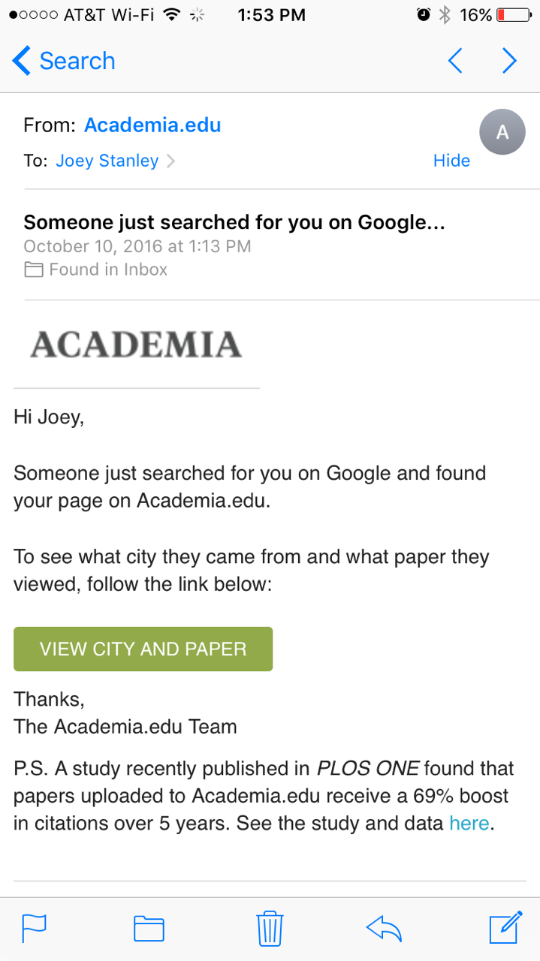
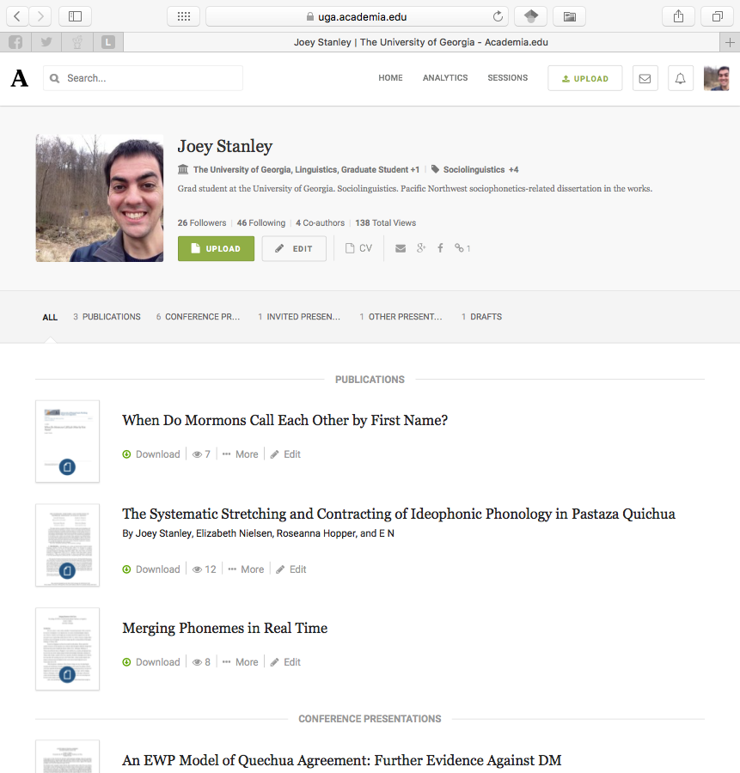
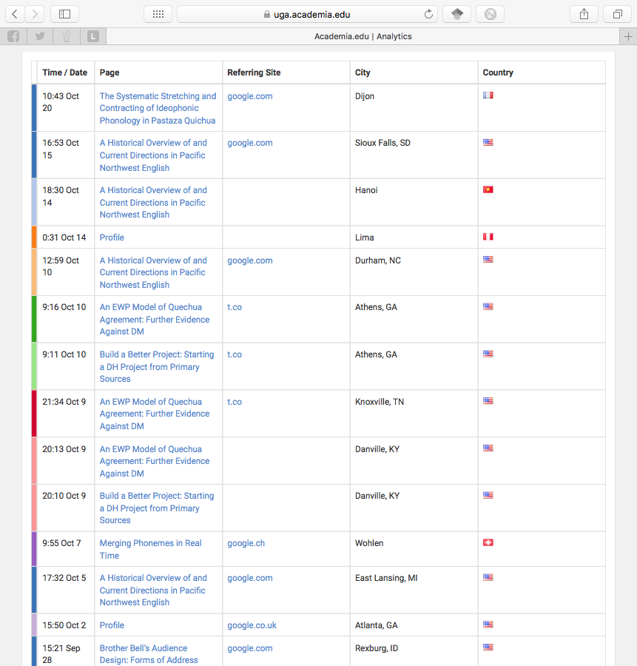
Academia.edu
Upload papers, presentations, drafts
upload your CV
abstracts, full text, slides, posters, links
GoogleScholar picks up on it
Analytics
time, paper, city, link
weekly summaries
notifications
Notes:
Get discovered

Slide 6
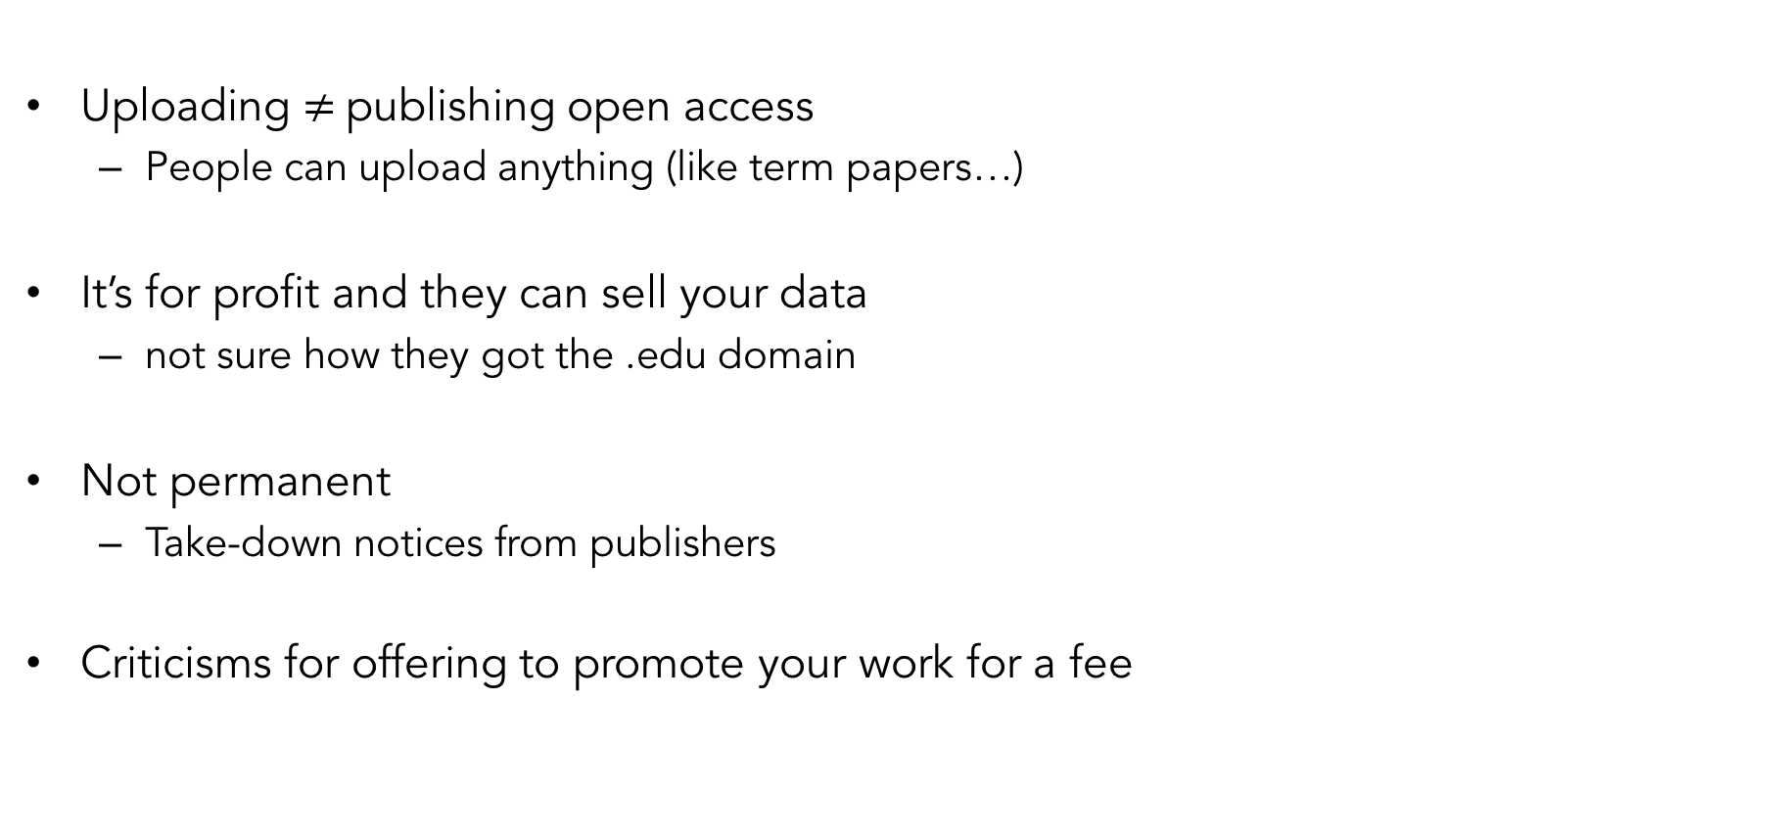
Academia.edu
Uploading $≠$publishing open access
People can upload anything (like term papers…)
It’s for profit and they can sell your data
not sure how they got the .edu domain
Not permanent
Take-down notices from publishers
Criticisms for offering to promote your work for a fee
Notes:
Criticisms

Slide 7
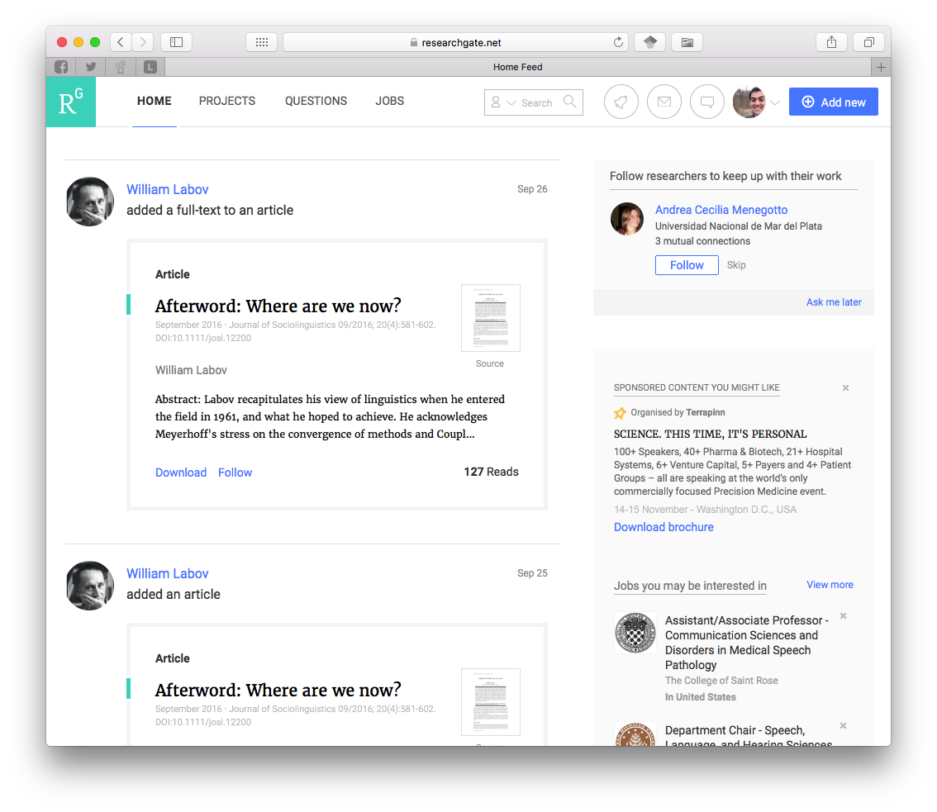
ResearchGate
Social networking site for scientists
9 million users
more international researchers
Lots of overlap with Academia.edu
Upload papers
Follow people and interests
Collaboration, feedback, commenting
Networks based on citations, co-authors
More people-based

Slide 8
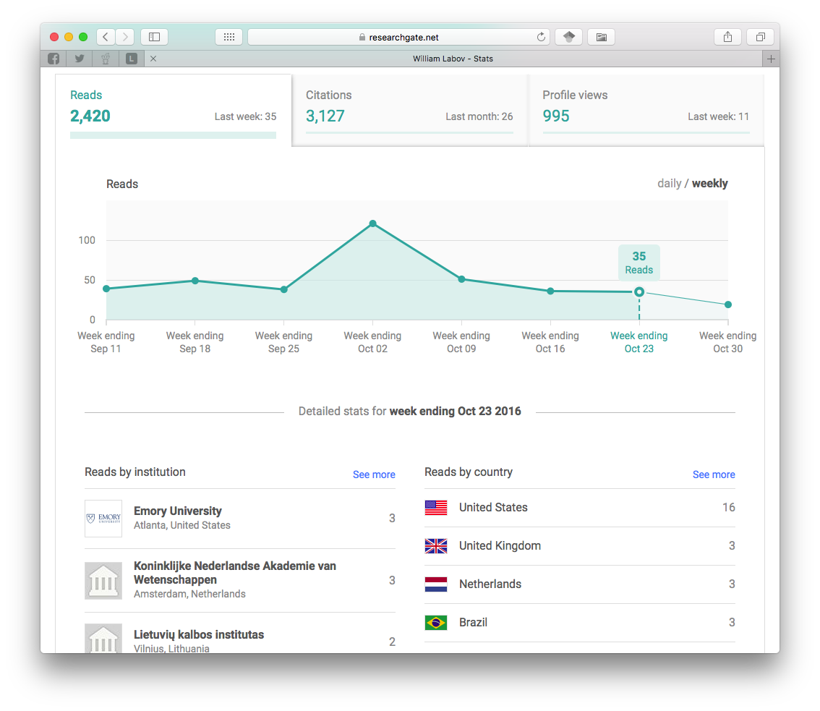
ResearchGate
Analytics
similar to Academia.edu
institutions instead of cities
number of citations
Criticisms
Spam invites to your co-authors
Automatically creates full-fledged accounts
Questionably-inflated citation counter

Slide 9
Google Scholar
Live demonstration with “American English: dialects and variation”
Adding material
sometimes automated, but manual work required
Limitations
Dirty data
Questionable citation counter
pulled from any source
easy to inflate with fake publications
Threat of disappearing at any time

Slide 10
Impact Story
A non-profit that helps scientists learn where their research is being cited, shared, saved and more
Links all your other accounts together
Tracks who cites, mentions, reads you
$10/month

Slide 11
Others
Mendeley
Small, but focused community
Zotero
Mostly citation management
some networking
LinkedIn
Just make a strong, low-maintenance profile

Slide 12
Share Your Work
Data repositories
Code
Slideshows

Slide 13
Profile Fatigue
Many profiles to maintain
Information silos
Can’t easily get info back from them
sites don’t talk to each other
Possible solution
Main page: full profile
Other pages
Later: What should be your main page?

Slide 14
Orcid Identifier
Permanent identifiers for researchers
copy and paste it to your pages
orcid.org/0000-0002-9185-0048
Help people know it’s you
similar name in your field
common last name
changed name
Some sites connect with your ORCID record

Slide 15
Personal Website

Slide 16
Personal Website
Some basics
servers and hosting
Cost (in money or skills)
domain name (yourname.com)
formatting, themes, design
googleability (”SEO”)
Don’t rely on a UGA-hosted webpage
little control over content
no control over appearance
can’t host PDFs and other files
no teaching, mentoring, service, etc.
A domain name (yourname.com) will cost you
but only (as little as) $10/year

Slide 17


Personal Website
Square Space
out-of-the-box, drag-and-drop
good themes
customizable
Google finds it
built-in blogging
example
$10+/month
WordPress
good themes
Google finds it
primarily blogging, though other pages possible
less control over aesthetics
example
free
Github pages
tech-savvy
Jekyll, CSS, Markdown
complete control
not as easily googleable
example
free

Slide 18
Personal Website
Essential components
short bio
recent photo
interests
teaching materials
contact
CV
important work
Optional material
list of all your works
personal interests/hobbies
Blog
shameless self-promotion
works in progress (not final results yet)
commenting on others’ work
community outreach
event promotion
explain your work to laypeople

Slide 19
Google Analytics
Tracks everything you’d ever want
Takes some computer know-how
Live demonstration (and shameless self-promotion…)
https://analytics.google.com/analytics/web/#report/defaultid/a86802921w129097126p132851130/

Slide 20
Find Your Community

Slide 21
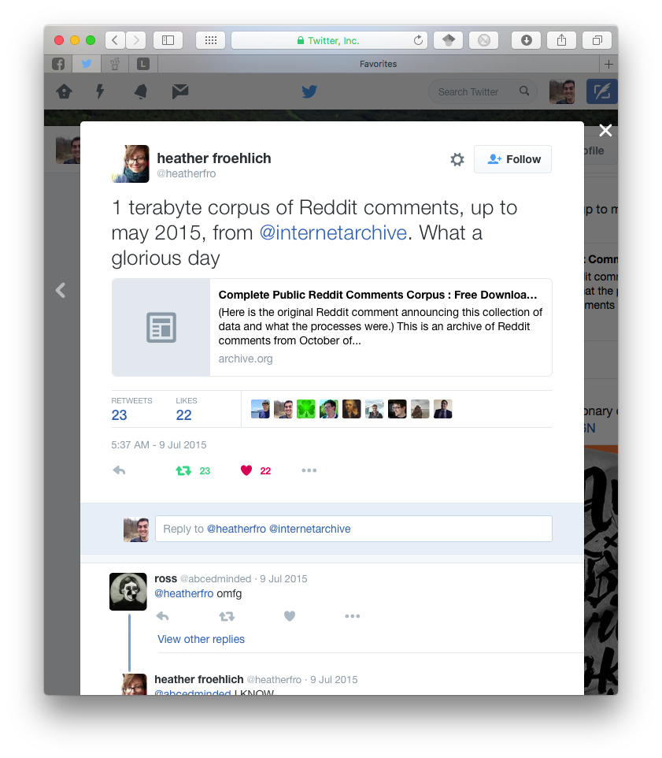
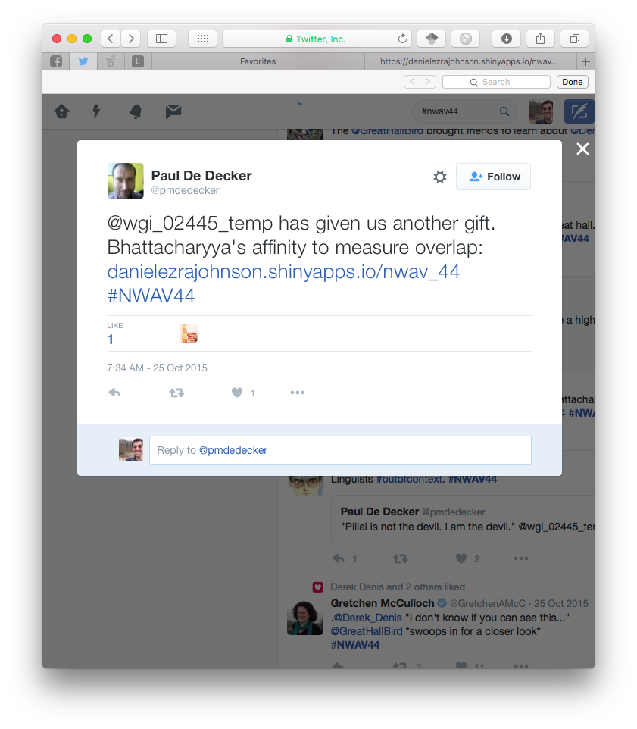
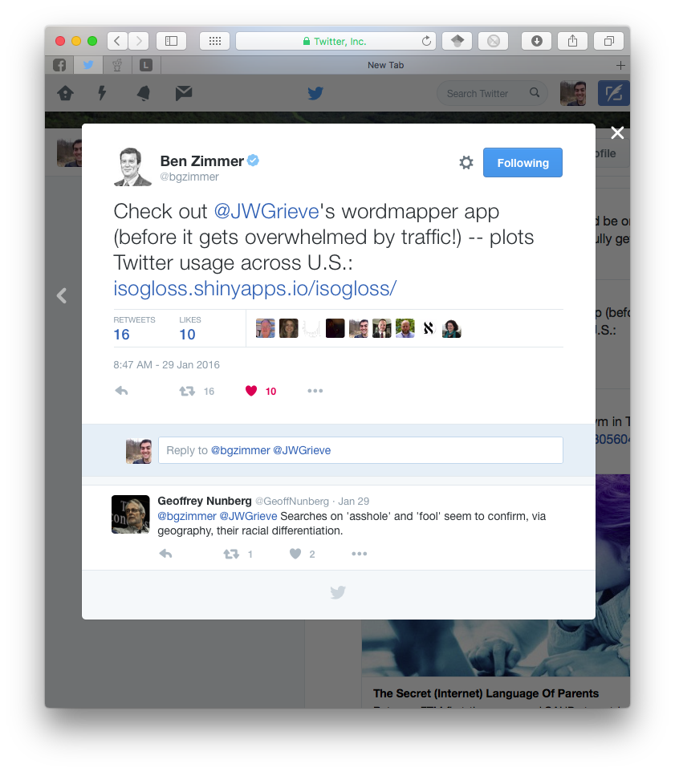
Twitter
Say what you want, Twitter is useful
What do researchers use Twitter for?
drafts, preprints
works in progress via blog posts
datasets
news, announcements
live tweeting conferences
slides, handouts
conversations
other cool stuff

Slide 22
Other Hidden Places
Listservs
Digital humanities
Slavic and East European Languages and Literatures List
SOCNET: The Social Networks Listserv
Coffee breaks at conferences
sociolinguistics

Slide 23
Credits
ImpactStory’s 30-Day Impact Challenge
series of blog posts
available as a (200+ page) pdf
http://blog.impactstory.org/research-impact-challenge-ebook/
very thorough and detailed
highly recommedned

